Slide 1
Ward wise analysis of Bhubaneshwar

Slide 2

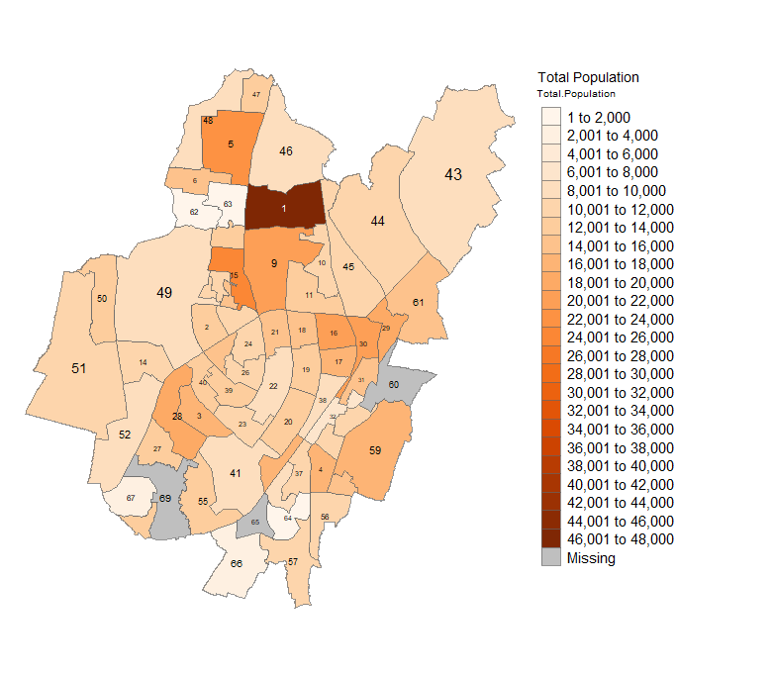
Bhubaneshwar is the capital city of Odisha with an estimate population of 849448.
Total no of wards =“69”
Ward no 1 has the highest population of 47574 .
Total Populaation

Slide 3
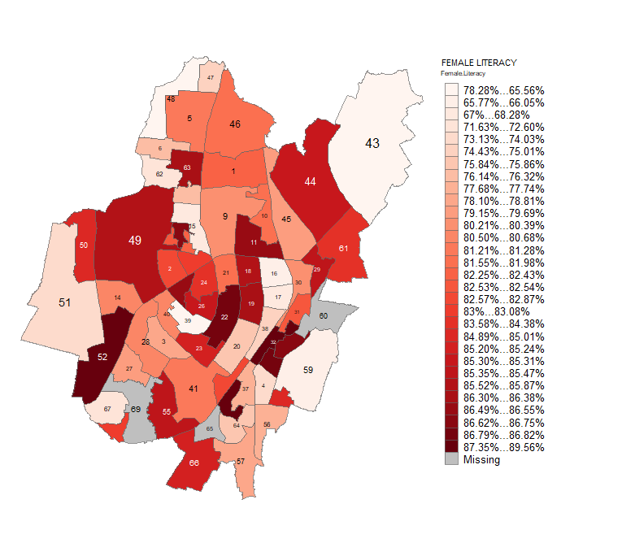
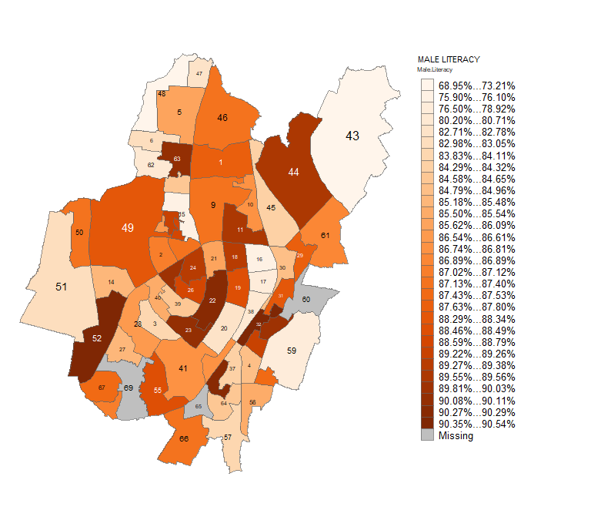
Literacy
Female
male

Slide 4
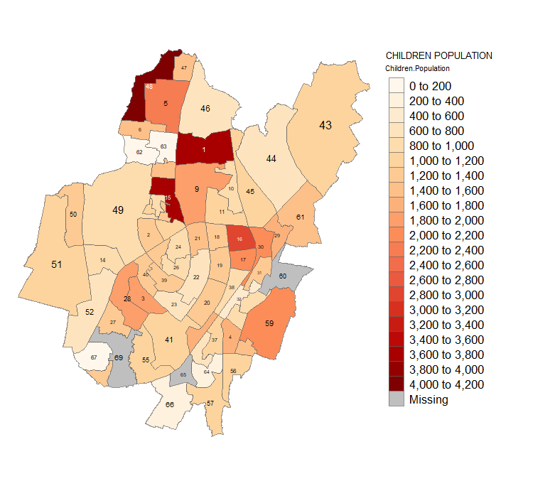
Female literacy vs Children population fe

Slide 5
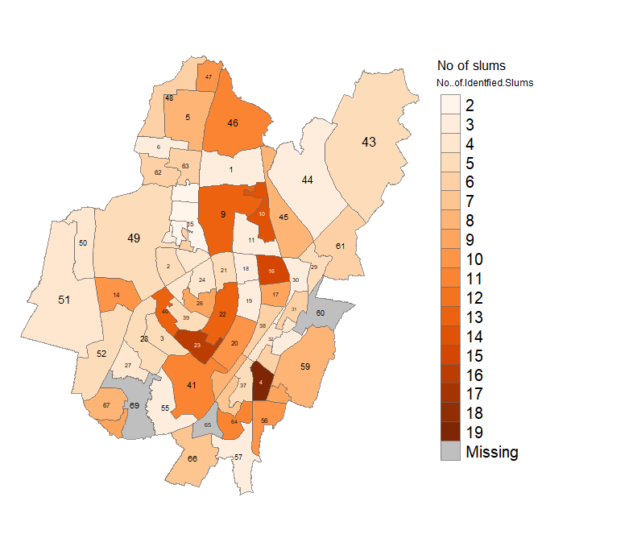
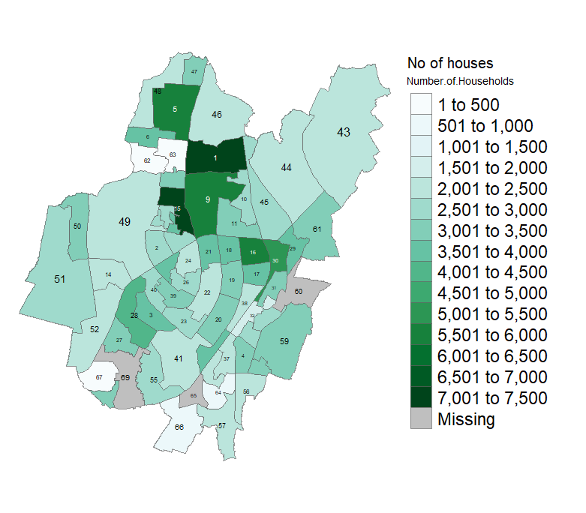
Informal settlements Vs Legal Houses

Slide 6
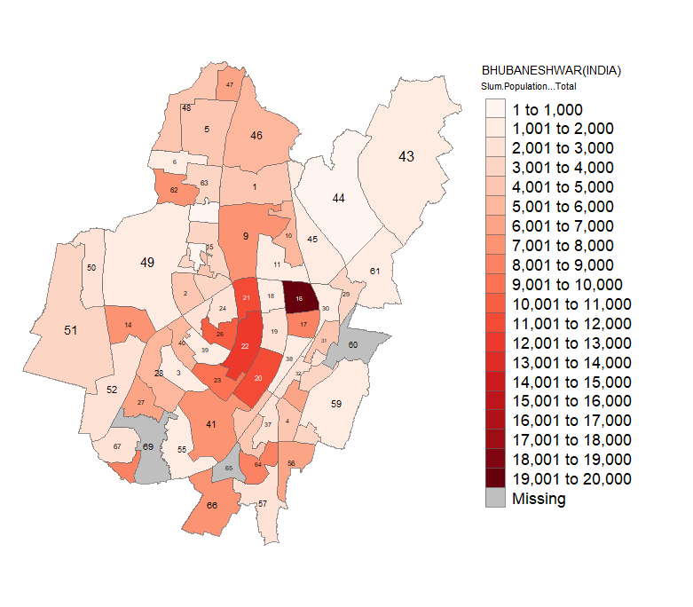
Slum population vs Total population

Slide 7
Thankyou

